Slide 1
图片

Slide 2




Slide 4
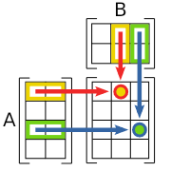
3
2
2
4

Slide 5
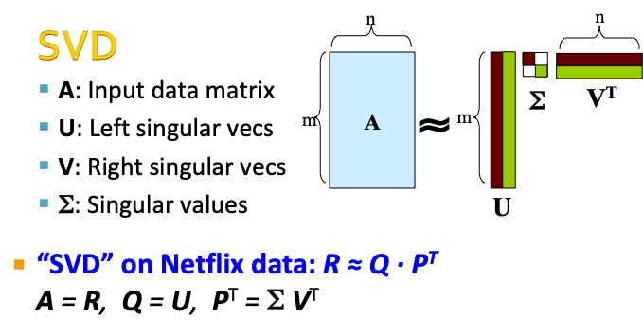
m
n
m
n

Slide 6
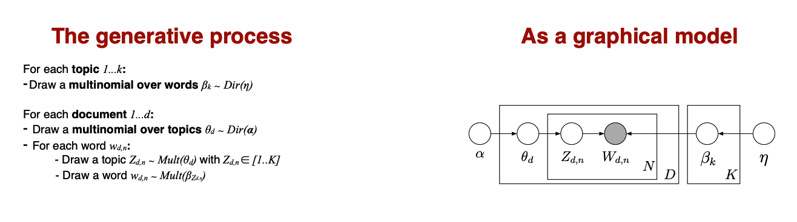
Dirichlet
Document-specific
topic distribution
Topic
Assignment
Observed
Word
Topic
Dirichlet

Slide 7





Slide 8
Data size = 2500
#Iterations=5
1st epoch
Dataset
batch1
batch2
batch3
batch4
batch5
Batch size = 500
2nd epoch
Dataset
Data Samples
Training
batch1
batch2
batch3
batch4
batch5
3rd epoch
batch1
batch2
batch3
batch4
batch5
Dataset

Slide 9
